Slide 1


CVS Promotion Overview
Which vaccines are you eligible for?
CVS tactics
Gap Analysis Tool: May 2020 – October 2021*^
Intermittent Text and video pulsing: Aug 2021 – February/March 2022*
Merck tactics
HCC : unbranded shelf shouters: July – November 2021*^
HCC Geotargeting: August - December 2021
HCP Digital (Doximity and PharmAlert Resource Center): Oct 2021 – May 2022
✓Flu
✓ Td/Tdap
✓ Zoster
HPV
* Indicates promotion is lost
^ Indicates a measurement of promotion impact was obtained

Slide 2
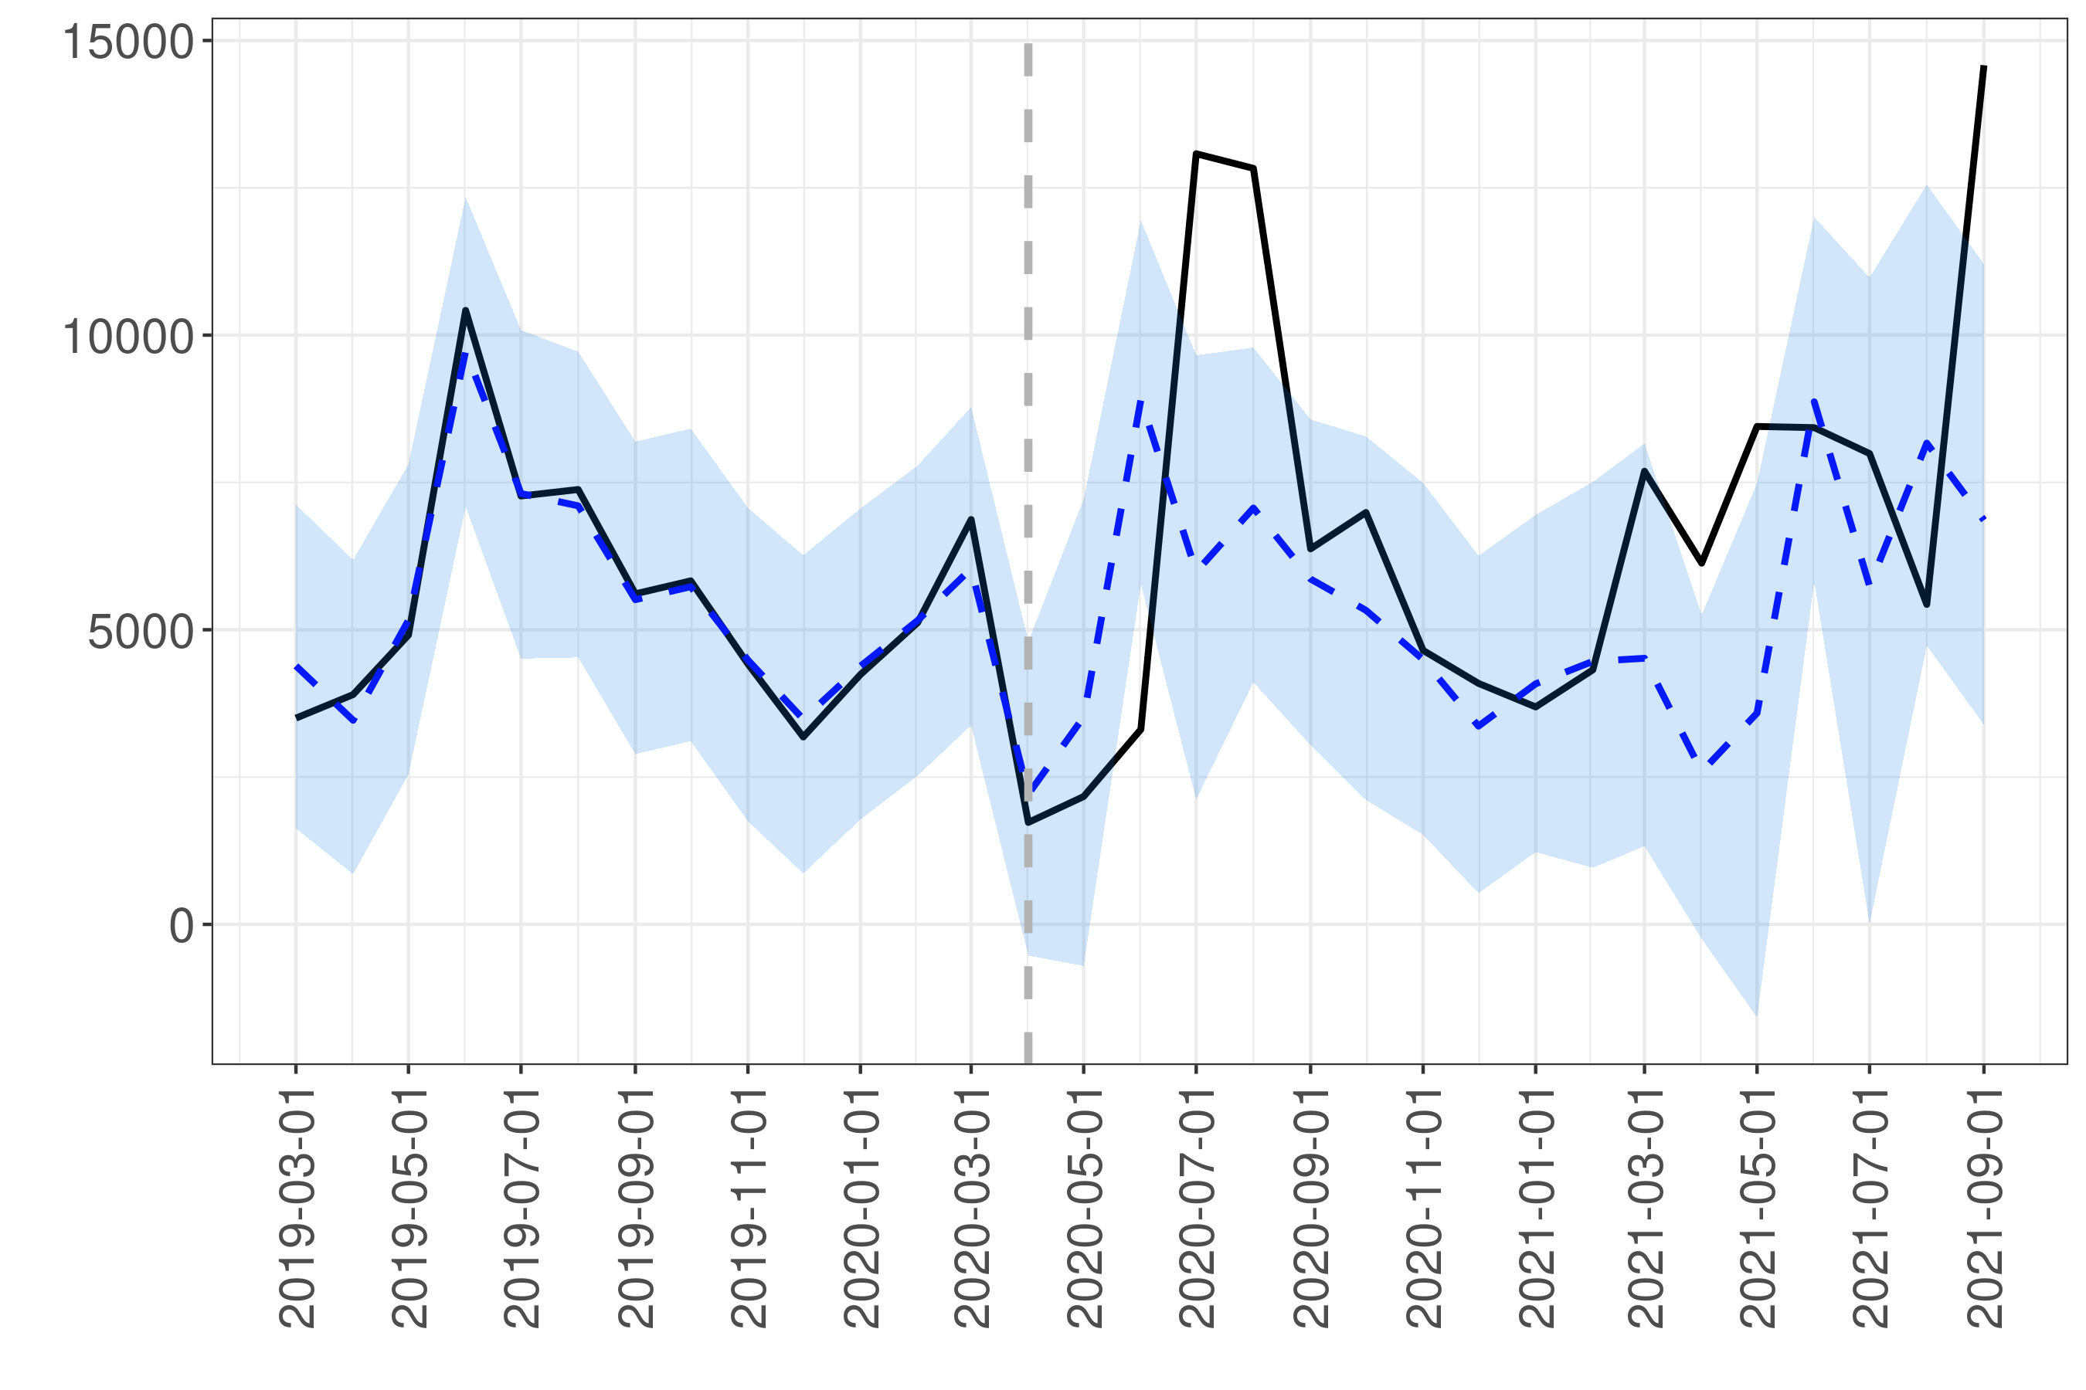

CVS Gap Tool Impact
Instep Impact
Combined Impact (2021)
Lower End (500 doses/month): $1.1 in yearly incr. revenue (accounting for seasonality)
Upper End (1100 doses/month): $2.4 in yearly incr. revenue
$725k in spend with 2.5 ROI (projected ROI based on hist. est.)
780k in yearly incr. revenue
Pharmacy initiated: between $1.9 - $3.2 could be lost (out of a max $6)
A discount of 3-5% would result in $800k - $1.3
Gap Tool Online
Synthetic Control
CVS
CVS: represented 43%
of total shelf shouters across all pharmacies
CVS Impact
Doses
Pre-Intervention
Post-Intervention
$27.2 in rev. from CVS in 2021
22% of claims are pharmacy initiated
CausalImpact: leverages the value of the target (CVS doses) pre “intervention” along with similar data streams (i.e., other pharmacy dose patterns) without the “intervention” (i.e., the tool) to create a synthetic control
Synthetic Control: how would doses in CVS have evolved if the gap tool didn’t exist?
*given this report is post-hoc these estimates may be conservative (e.g., not accounting for adult brand growth)
*yearly estimates based on 2021 dose pricing

